Slide 1
One – Sided Limits

Slide 2
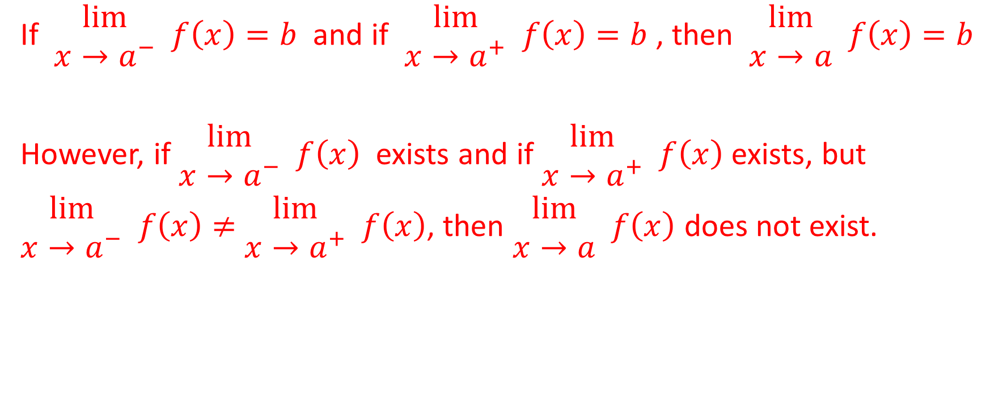
Recall this Statement About Limits
If $\begin{matrix}lim⁡ \\ x→a^{−}\end{matrix} f\left(x\right)=b$ and if $\begin{matrix}lim⁡ \\ x→a^{+}\end{matrix} f\left(x\right)=b$ , then $\begin{matrix}lim⁡ \\ x→a\end{matrix} f\left(x\right)=b$
However, if $\begin{matrix}lim⁡ \\ x→a^{−}\end{matrix} f\left(x\right)$ exists and if $\begin{matrix}lim⁡ \\ x→a^{+}\end{matrix} f\left(x\right)$ exists, but
$\begin{matrix}lim⁡ \\ x→a^{−}\end{matrix} f\left(x\right)≠$ $\begin{matrix}lim⁡ \\ x→a^{+}\end{matrix} f\left(x\right)$, then $\begin{matrix}lim⁡ \\ x→a\end{matrix} f\left(x\right)$ does not exist.

Slide 3
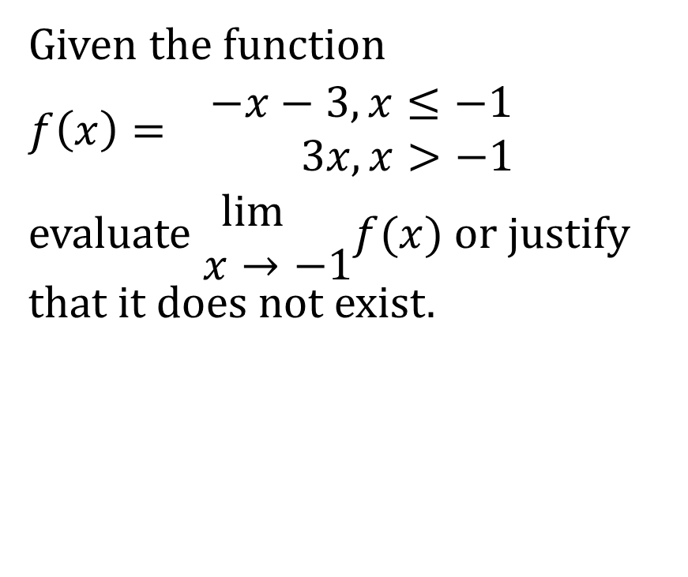
Recall This Example From a Previous Slideshow
Given the function
$f\left(x\right)= \begin{matrix}−x−3,x≤−1 \\ 3x,x>−1\end{matrix}$
evaluate $\begin{matrix}\lim{} \\ x→−1\end{matrix}f(x)$ or justify that it does not exist.

Slide 4
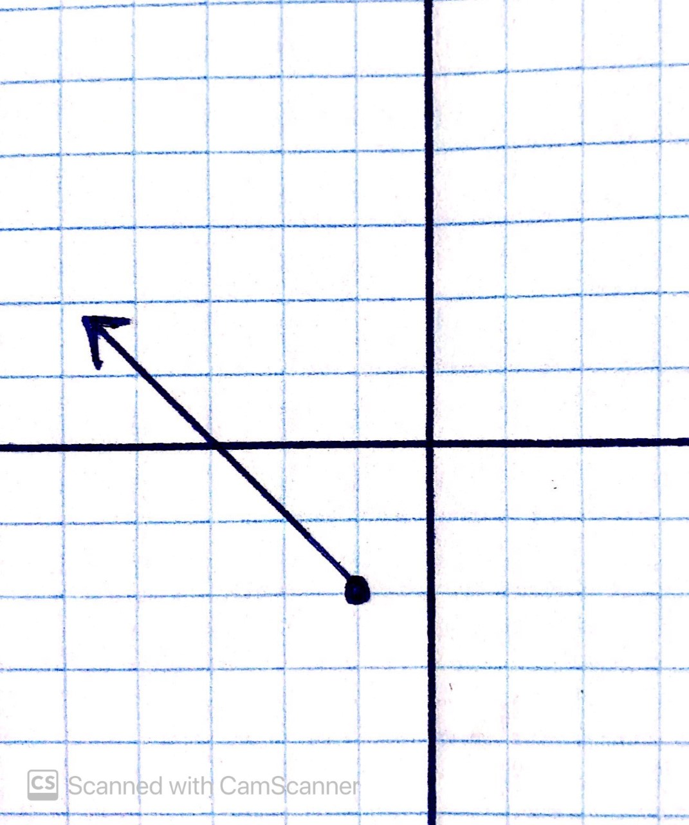
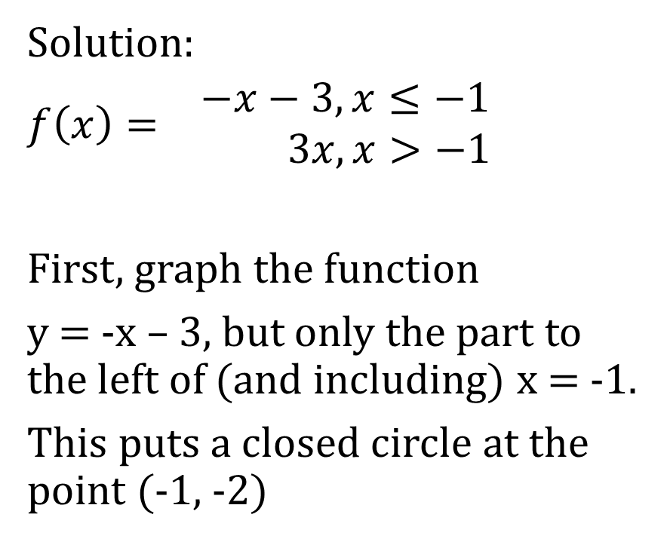
Solution:
$f\left(x\right)= \begin{matrix}−x−3,x≤−1 \\ 3x,x>−1\end{matrix}$
First, graph the function
y = -x – 3, but only the part to the left of (and including) x = -1.
This puts a closed circle at the point (-1, -2)

Slide 5
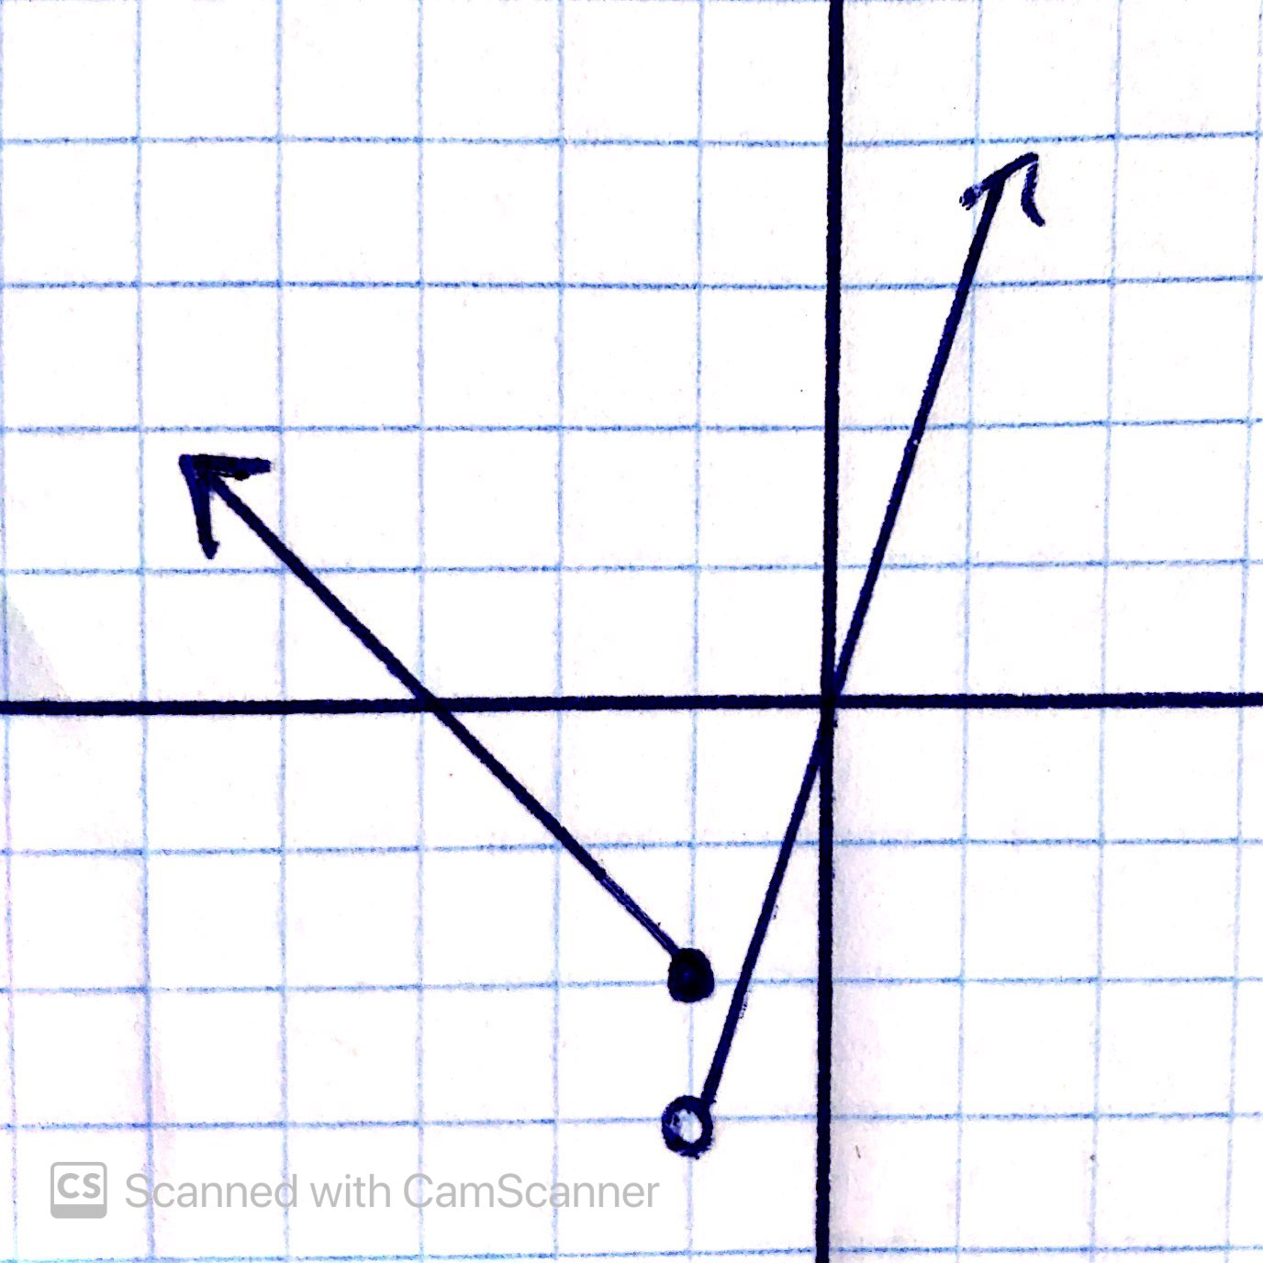
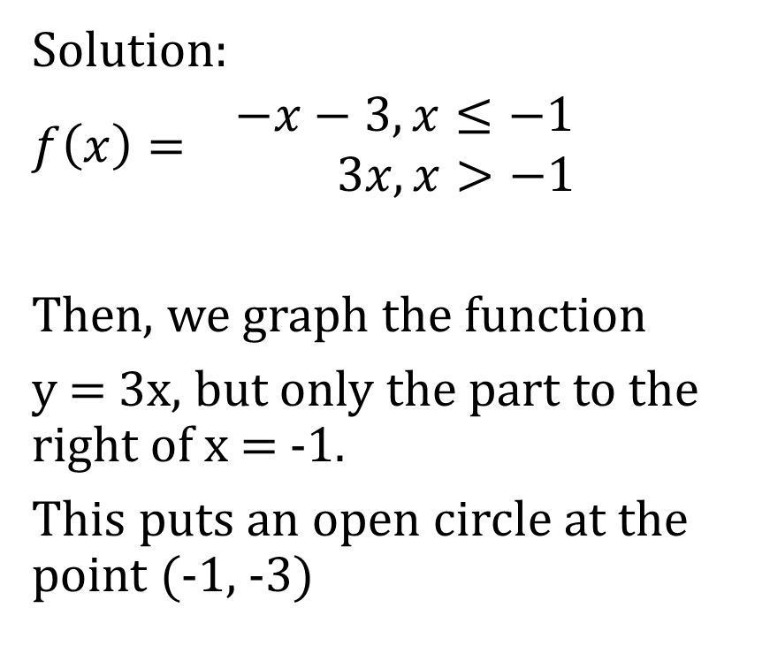
Solution:
$f\left(x\right)= \begin{matrix}−x−3,x≤−1 \\ 3x,x>−1\end{matrix}$
Then, we graph the function
y = 3x, but only the part to the right of x = -1.
This puts an open circle at the point (-1, -3)

Slide 6

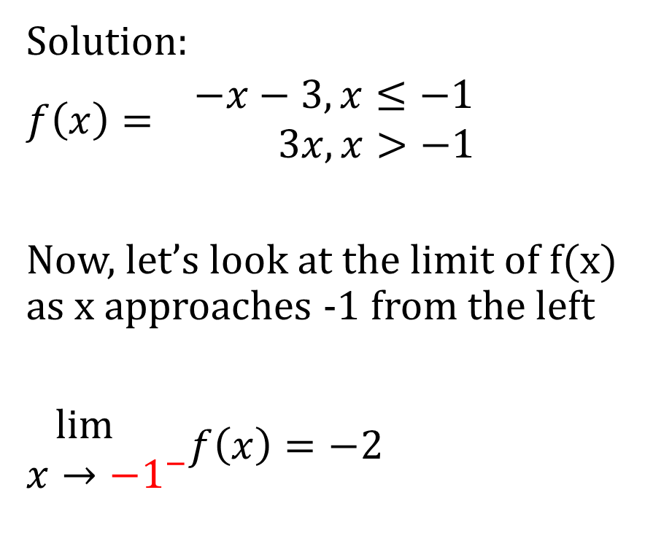
Solution:
$f\left(x\right)= \begin{matrix}−x−3,x≤−1 \\ 3x,x>−1\end{matrix}$
Now, let’s look at the limit of f(x) as x approaches -1 from the left
$\begin{matrix}\lim{} \\ x→−1^{−}\end{matrix}f\left(x\right)=−2$

Slide 7
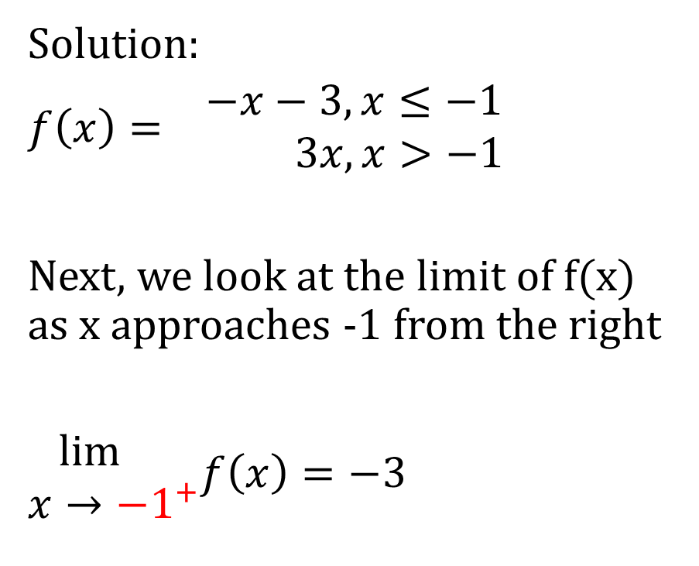
Solution:
$f\left(x\right)= \begin{matrix}−x−3,x≤−1 \\ 3x,x>−1\end{matrix}$
Next, we look at the limit of f(x) as x approaches -1 from the right
$\begin{matrix}\lim{} \\ x→−1^{+}\end{matrix}f\left(x\right)=−3$

Slide 8
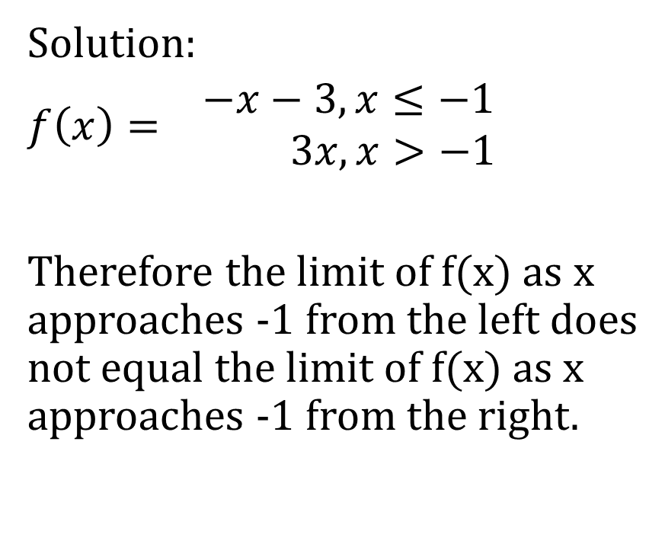
Solution:
$f\left(x\right)= \begin{matrix}−x−3,x≤−1 \\ 3x,x>−1\end{matrix}$
Therefore the limit of f(x) as x approaches -1 from the left does not equal the limit of f(x) as x approaches -1 from the right.

Slide 9
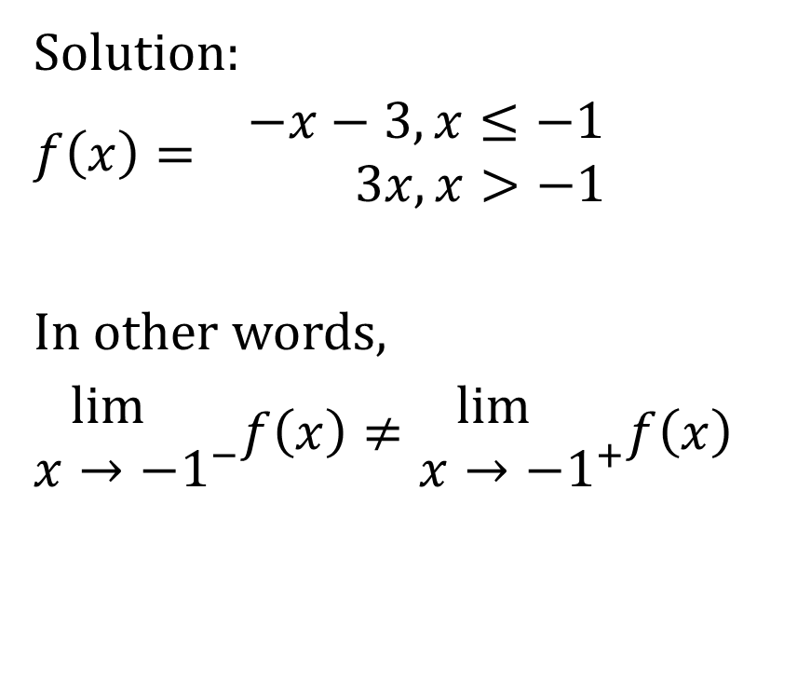
Solution:
$f\left(x\right)= \begin{matrix}−x−3,x≤−1 \\ 3x,x>−1\end{matrix}$
In other words,
$\begin{matrix}\lim{} \\ x→−1^{−}\end{matrix}f\left(x\right)≠\begin{matrix}\lim{} \\ x→−1^{+}\end{matrix}f\left(x\right)$

Slide 10
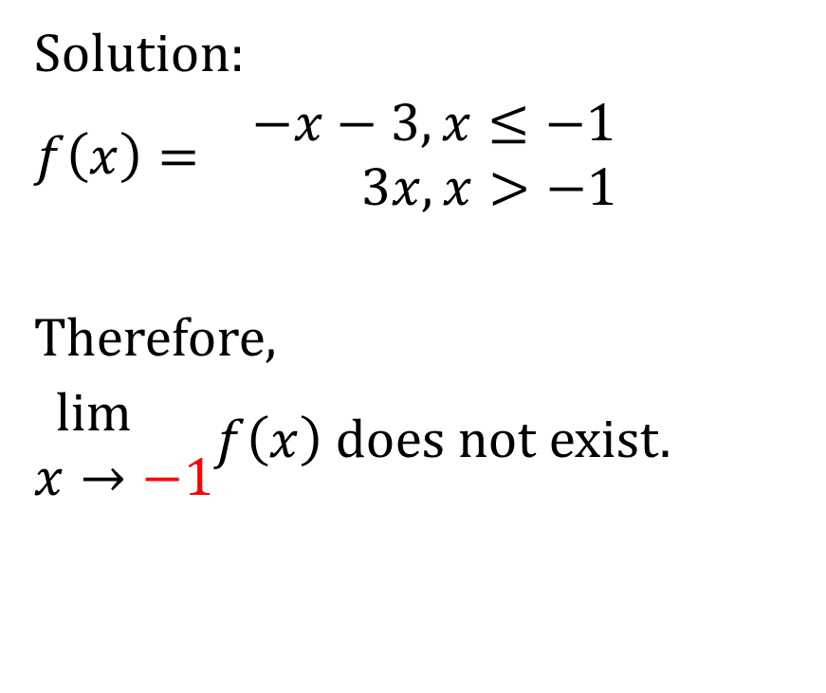
Solution:
$f\left(x\right)= \begin{matrix}−x−3,x≤−1 \\ 3x,x>−1\end{matrix}$
Therefore,
$\begin{matrix}\lim{} \\ x→−1\end{matrix}f\left(x\right)$ does not exist.

Slide 11

Recall This Example From a Previous Slideshow
Evaluate the following using a graphing approach
$\begin{matrix}lim⁡ \\ x→2\end{matrix}\left(\sqrt{x−2}+3\right)$

Slide 12
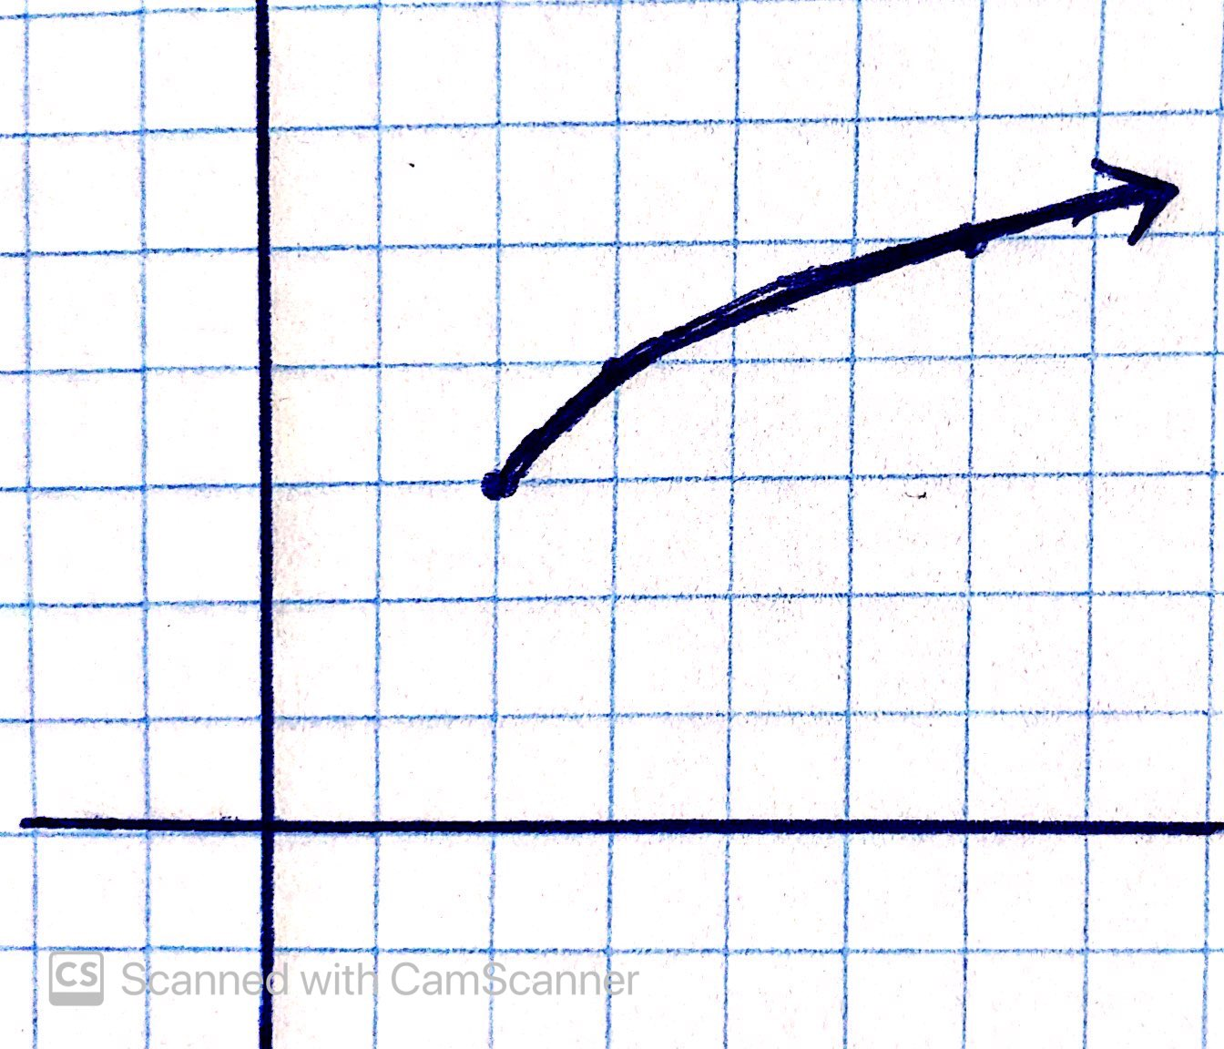
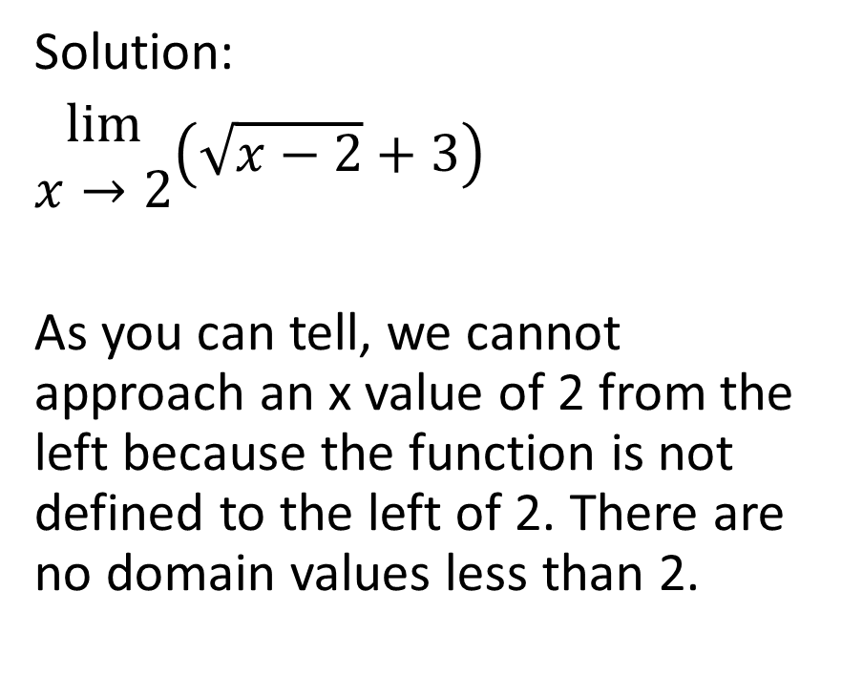

Solution:
$\begin{matrix}lim⁡ \\ x→2\end{matrix}\left(\sqrt{x−2}+3\right)$
As you can tell, we cannot approach an x value of 2 from the left because the function is not defined to the left of 2. There are no domain values less than 2.

Slide 13
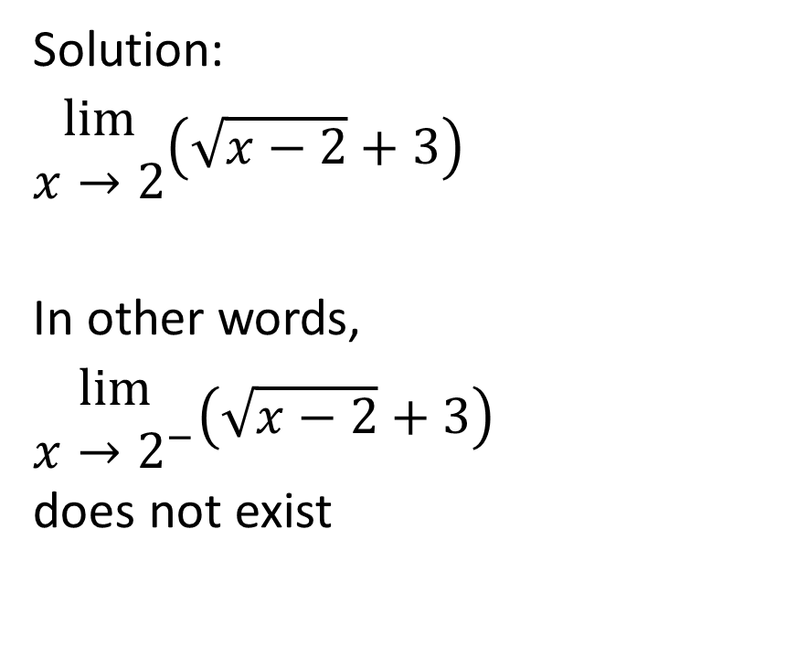
Solution:
$\begin{matrix}lim⁡ \\ x→2\end{matrix}\left(\sqrt{x−2}+3\right)$
In other words,
$\begin{matrix}lim⁡ \\ x→2^{−}\end{matrix}\left(\sqrt{x−2}+3\right)$
does not exist

Slide 14
Solution:
However, in this specific circumstance, where the function is not defined at all on one side of the x-value in question but is defined on the other side, we focus solely on the side on which the function is defined.

Slide 15
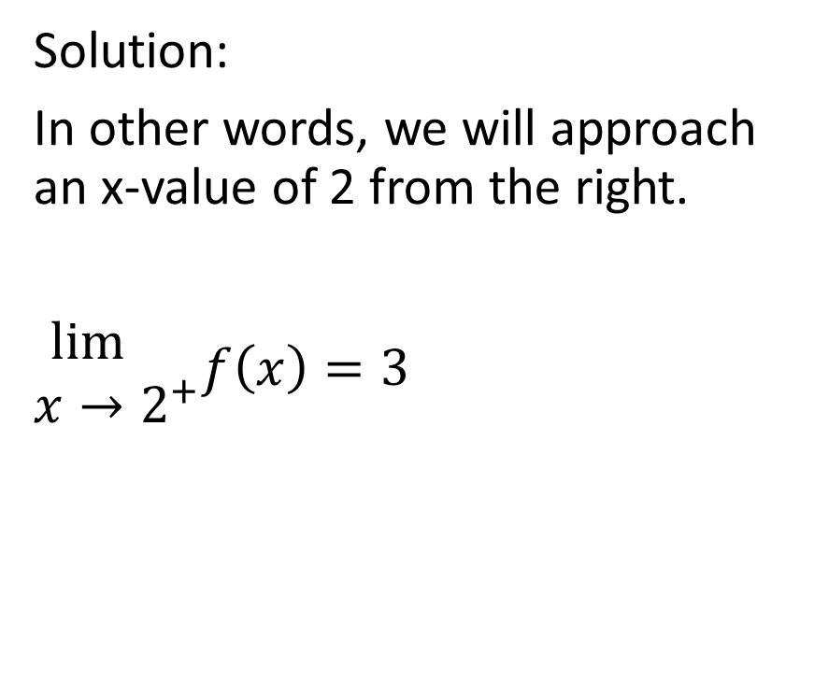

Solution:
In other words, we will approach an x-value of 2 from the right.
$\begin{matrix}\lim{} \\ x→2^{+}\end{matrix}f\left(x\right)=3$

Slide 16
Solution:
Since that is the only direction from which we can approach this x-value, therefore we state the value of that one-sided limit as the value of the limit of the function as x approaches 2.

Slide 17

Solution:
In other words,
$\begin{matrix}\lim{} \\ x→2\end{matrix}f\left(x\right)=3$

Slide 18

Example
Evaluate
$\begin{matrix}lim⁡ \\ x→0\end{matrix} \left|x\right|$

Slide 19
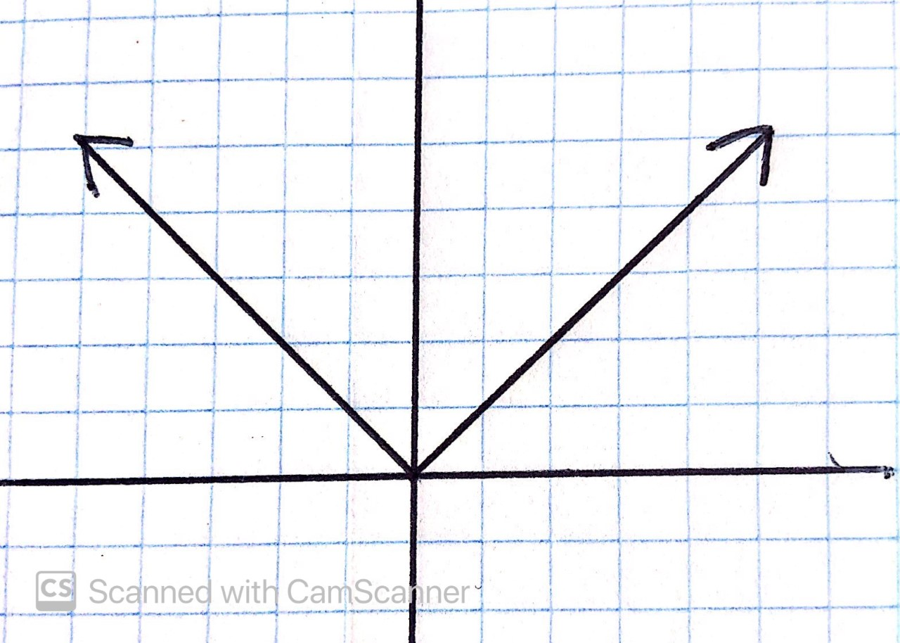

Evaluate
$\begin{matrix}lim⁡ \\ x→0\end{matrix} \left|x\right|$
Solution:
Draw a diagram

Slide 20


Evaluate
$\begin{matrix}lim⁡ \\ x→0\end{matrix} \left|x\right|$
Solution:
$\begin{matrix}lim⁡ \\ x→0^{−}\end{matrix} \left|x\right|=0$

Slide 21


Evaluate
$\begin{matrix}lim⁡ \\ x→0\end{matrix} \left|x\right|$
Solution:
$\begin{matrix}lim⁡ \\ x→0^{−}\end{matrix} \left|x\right|=0$
$\begin{matrix}lim⁡ \\ x→0^{+}\end{matrix} \left|x\right|=0$

Slide 22
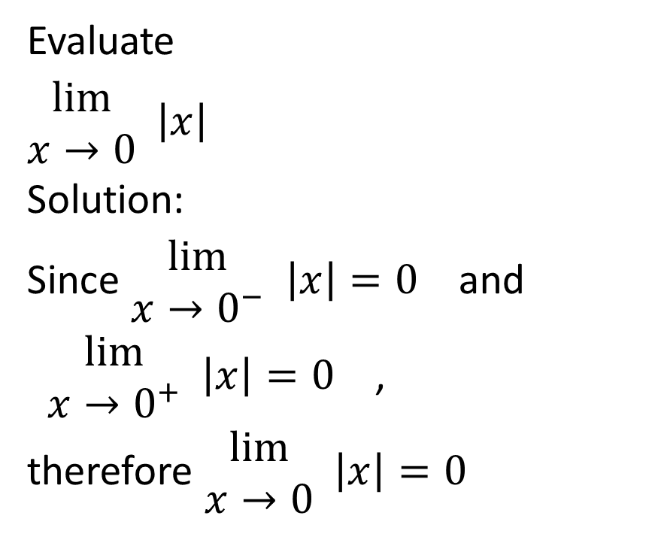
Evaluate
$\begin{matrix}lim⁡ \\ x→0\end{matrix} \left|x\right|$
Solution:
Since $\begin{matrix}lim⁡ \\ x→0^{−}\end{matrix} \left|x\right|=0$ and
$\begin{matrix}lim⁡ \\ x→0^{+}\end{matrix} \left|x\right|=0$ ,
therefore $\begin{matrix}lim⁡ \\ x→0\end{matrix} \left|x\right|=0$

Slide 23

Example
Evaluate, if possible,
$\begin{matrix}lim⁡ \\ x→4\end{matrix} \frac{\left|x−4\right|}{x−4}$

Slide 24
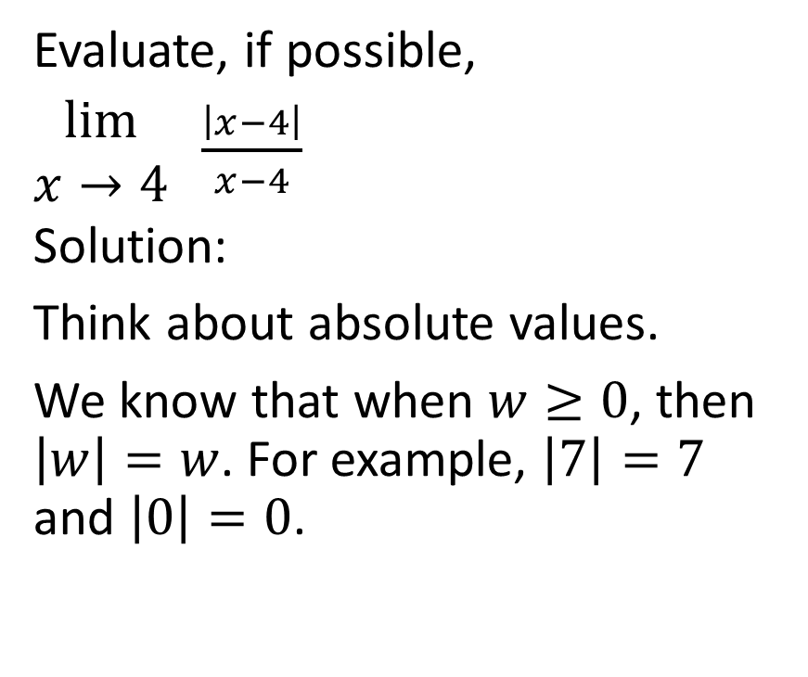
Evaluate, if possible,
$\begin{matrix}lim⁡ \\ x→4\end{matrix} \frac{\left|x−4\right|}{x−4}$
Solution:
Think about absolute values.
We know that when $w≥0$, then $\left|w\right|=w$. For example, $\left|7\right|=7$ and $\left|0\right|=0$.

Slide 25
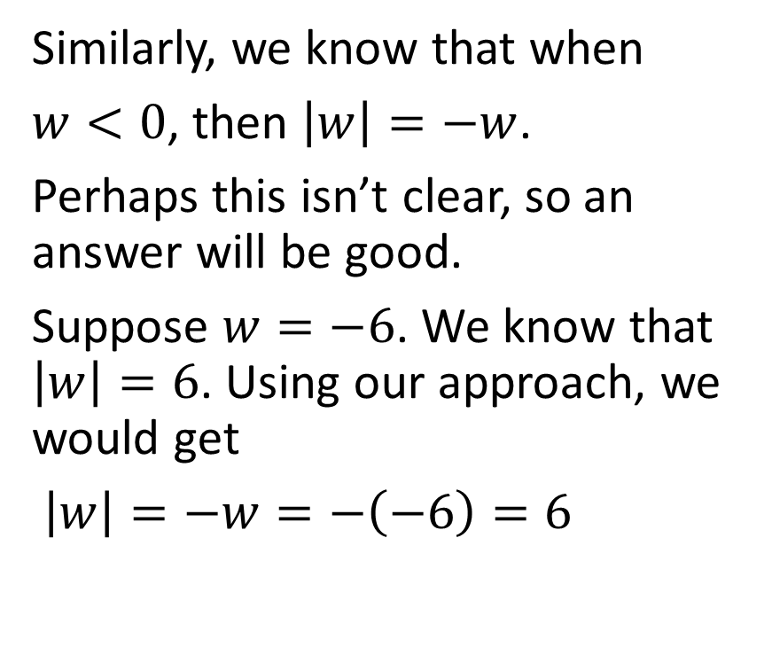
Evaluate, if possible,
$\begin{matrix}lim⁡ \\ x→4\end{matrix} \frac{\left|x−4\right|}{x−4}$
Solution:
Think about absolute values.
We know that when $w≥0$, then $\left|w\right|=w$. For example, $\left|7\right|=7$ and $\left|0\right|=0$.
Similarly, we know that when
$w<0$, then $\left|w\right|=−w$.
Perhaps this isn’t clear, so an answer will be good.
Suppose $w=−6$. We know that $\left|w\right|=6$. Using our approach, we would get
$\left|w\right|=−w=−\left(−6\right)=6$

Slide 26
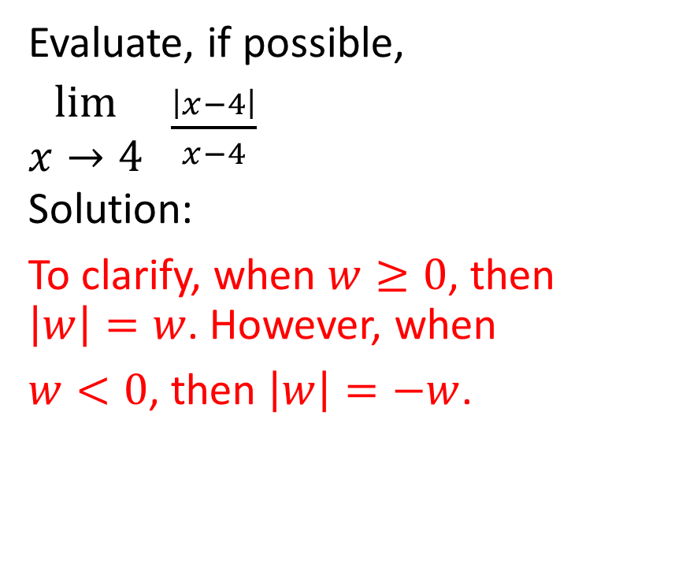
Evaluate, if possible,
$\begin{matrix}lim⁡ \\ x→4\end{matrix} \frac{\left|x−4\right|}{x−4}$
Solution:
To clarify, when $w≥0$, then $\left|w\right|=w$. However, when
$w<0$, then $\left|w\right|=−w$.

Slide 27
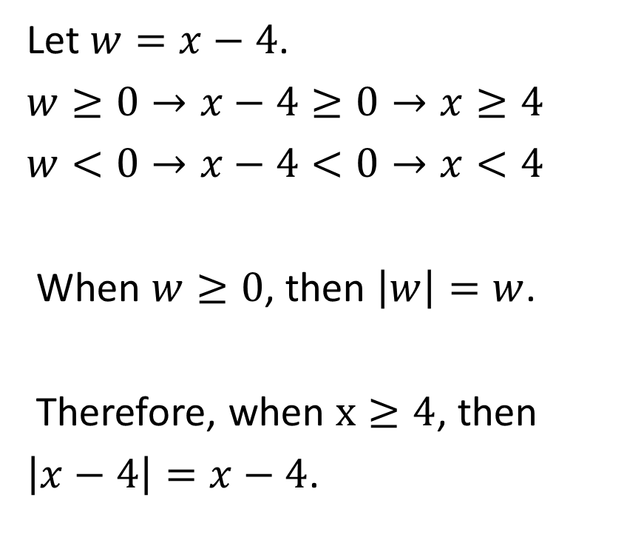
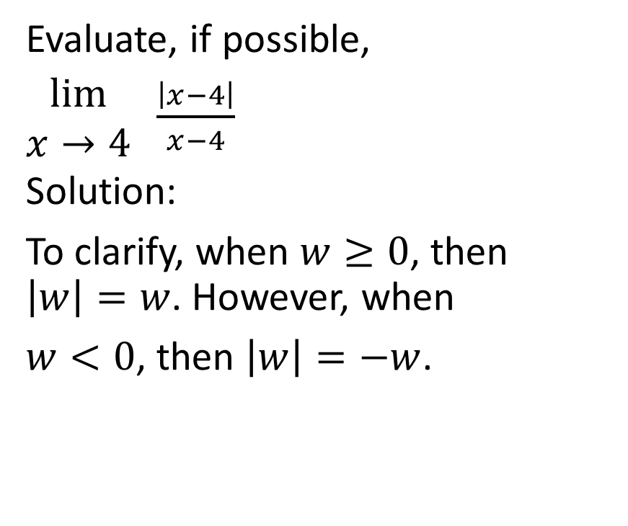
Evaluate, if possible,
$\begin{matrix}lim⁡ \\ x→4\end{matrix} \frac{\left|x−4\right|}{x−4}$
Solution:
To clarify, when $w≥0$, then $\left|w\right|=w$. However, when
$w<0$, then $\left|w\right|=−w$.
Let $w=x−4$.
$w≥0→x−4≥0→x≥4$
$w<0→x−4<0→x<4$
When $w≥0$, then $\left|w\right|=w$.
Therefore, when $x≥4$, then
$\left|x−4\right|=x−4$.

Slide 28
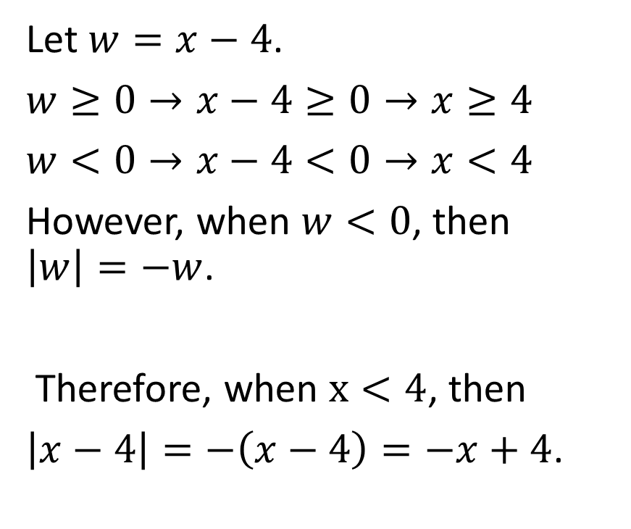
Evaluate, if possible,
$\begin{matrix}lim⁡ \\ x→4\end{matrix} \frac{\left|x−4\right|}{x−4}$
Solution:
To clarify, when $w≥0$, then $\left|w\right|=w$. However, when
$w<0$, then $\left|w\right|=−w$.
Let $w=x−4$.
$w≥0→x−4≥0→x≥4$
$w<0→x−4<0→x<4$
However, when $w<0$, then $\left|w\right|=−w$.
Therefore, when $x<4$, then
$\left|x−4\right|=−\left(x−4\right)=−x+4$.

Slide 29
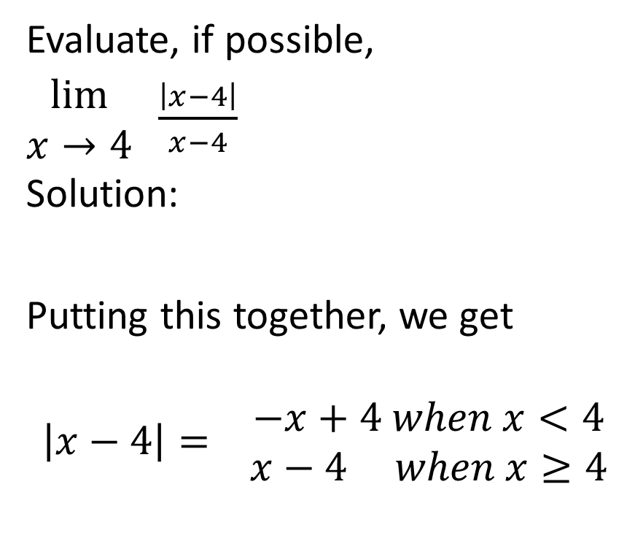
Evaluate, if possible,
$\begin{matrix}lim⁡ \\ x→4\end{matrix} \frac{\left|x−4\right|}{x−4}$
Solution:
Putting this together, we get
$$\left|x−4\right|= \begin{matrix}−x+4 when x<4 \\ x−4 when x≥4\end{matrix}$$

Slide 30

Evaluate, if possible,
$\begin{matrix}lim⁡ \\ x→4\end{matrix} \frac{\left|x−4\right|}{x−4}$
Solution:
Putting this together, we get
$$\left|x−4\right|= \begin{matrix}−x+4 when x<4 \\ x−4 when x≥4\end{matrix}$$
Therefore, when $x<4$, then
$\frac{\left|x−4\right|}{x−4}=\frac{−x+4}{x−4}=\frac{−(x−4)}{(x−4)}=\frac{−1}{1}$
$=−1$

Slide 31

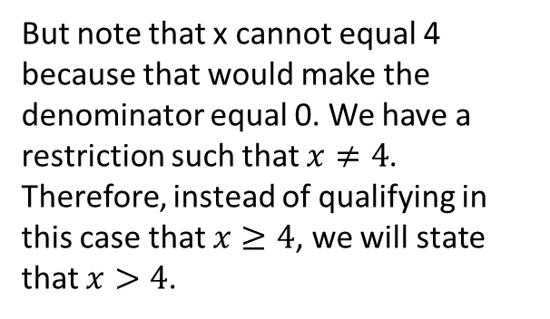
Evaluate, if possible,
$\begin{matrix}lim⁡ \\ x→4\end{matrix} \frac{\left|x−4\right|}{x−4}$
Solution:
Putting this together, we get
$$\left|x−4\right|= \begin{matrix}−x+4 when x<4 \\ x−4 when x≥4\end{matrix}$$
Similarly, when $x≥4$, then
$\frac{\left|x−4\right|}{x−4}=\frac{x−4}{x−4}=\frac{(x−4)}{(x−4)}=\frac{1}{1}$
$=1$
But note that x cannot equal 4 because that would make the denominator equal 0. We have a restriction such that $x≠4$. Therefore, instead of qualifying in this case that $x≥4$, we will state that $x>4$.

Slide 32

Evaluate, if possible,
$\begin{matrix}lim⁡ \\ x→4\end{matrix} \frac{\left|x−4\right|}{x−4}$
Solution:
Putting this together, we get
$$\left|x−4\right|= \begin{matrix}−x+4 when x<4 \\ x−4 when x≥4\end{matrix}$$
Similarly, when $x>4$, then
$\frac{\left|x−4\right|}{x−4}=\frac{x−4}{x−4}=\frac{(x−4)}{(x−4)}=\frac{1}{1}$
$=1$

Slide 33
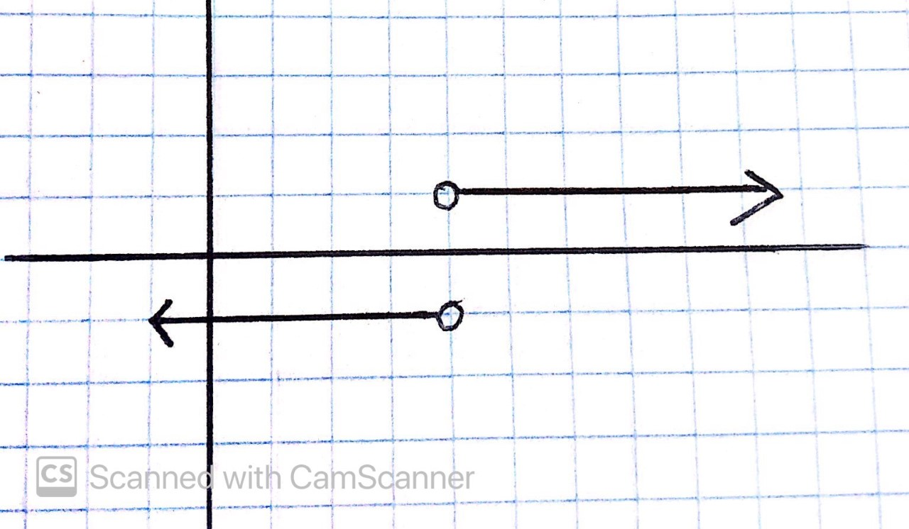
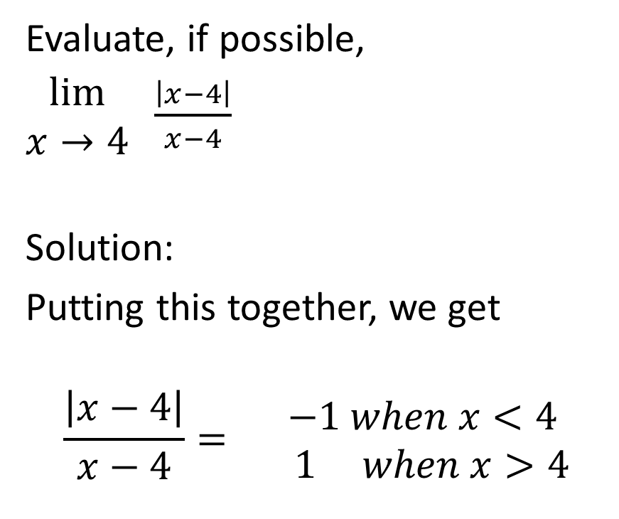

Evaluate, if possible,
$\begin{matrix}lim⁡ \\ x→4\end{matrix} \frac{\left|x−4\right|}{x−4}$
Solution:
Putting this together, we get
$$\frac{\left|x−4\right|}{x−4}= \begin{matrix} −1 when x<4 \\ 1 when x>4\end{matrix}$$

Slide 34

Evaluate, if possible,
$\begin{matrix}lim⁡ \\ x→4\end{matrix} \frac{\left|x−4\right|}{x−4}$
Solution:
$\begin{matrix}lim⁡ \\ x→4^{−}\end{matrix} \frac{\left|x−4\right|}{x−4}=−1$

Slide 35
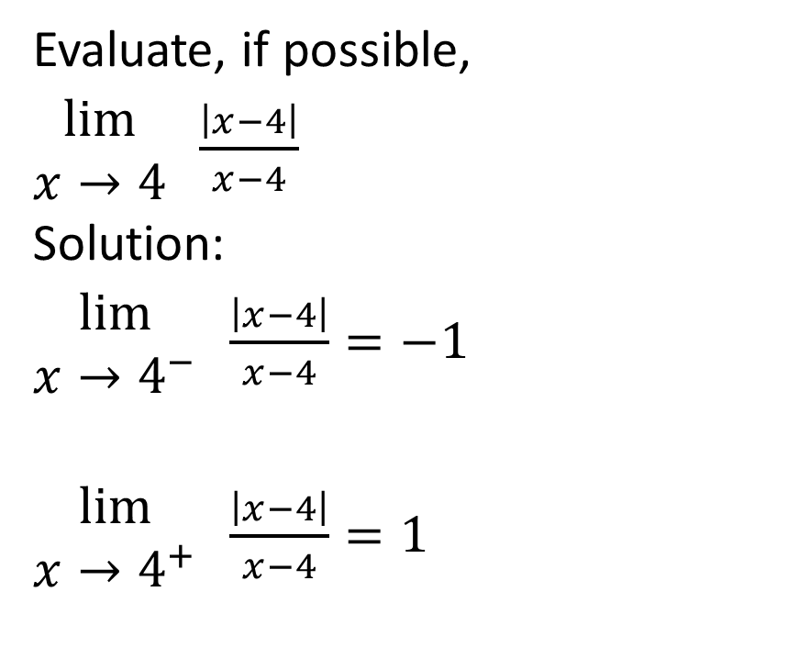
Evaluate, if possible,
$\begin{matrix}lim⁡ \\ x→4\end{matrix} \frac{\left|x−4\right|}{x−4}$
Solution:
$\begin{matrix}lim⁡ \\ x→4^{−}\end{matrix} \frac{\left|x−4\right|}{x−4}=−1$
$\begin{matrix}lim⁡ \\ x→4^{+}\end{matrix} \frac{\left|x−4\right|}{x−4}=1$

Slide 36
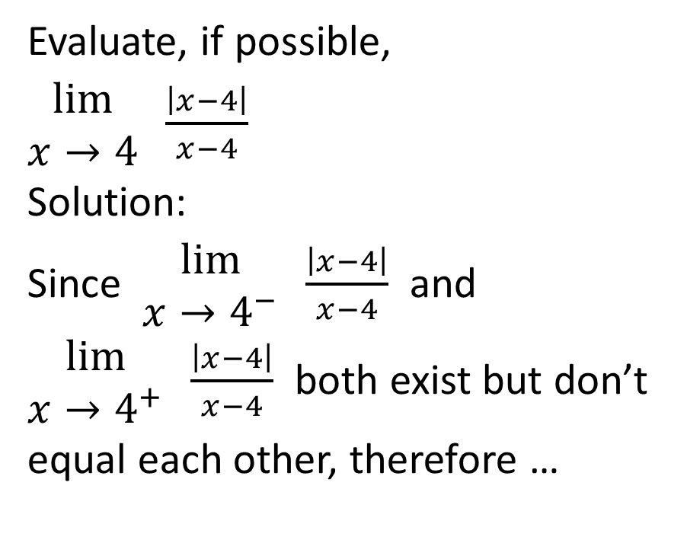
Evaluate, if possible,
$\begin{matrix}lim⁡ \\ x→4\end{matrix} \frac{\left|x−4\right|}{x−4}$
Solution:
Since $\begin{matrix}lim⁡ \\ x→4^{−}\end{matrix} \frac{\left|x−4\right|}{x−4}$ and
$\begin{matrix}lim⁡ \\ x→4^{+}\end{matrix} \frac{\left|x−4\right|}{x−4}$ both exist but don’t
equal each other, therefore …

Slide 37
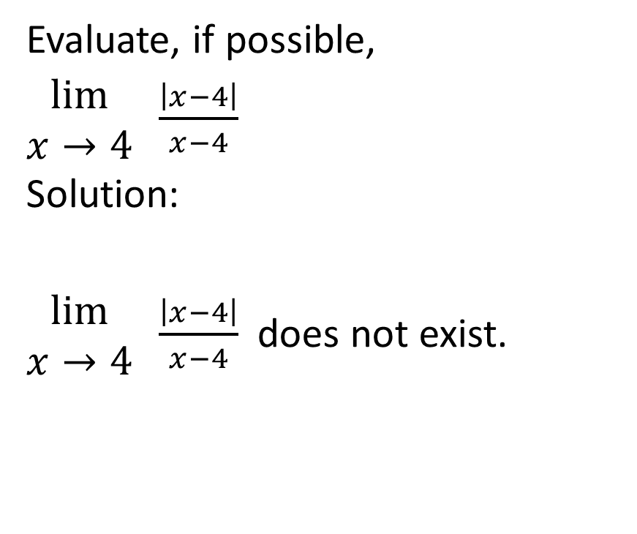
Evaluate, if possible,
$\begin{matrix}lim⁡ \\ x→4\end{matrix} \frac{\left|x−4\right|}{x−4}$
Solution:
$\begin{matrix}lim⁡ \\ x→4\end{matrix} \frac{\left|x−4\right|}{x−4}$does not exist.

